Slide 1

RedHat Linux and Open Source Workshop

Slide 2
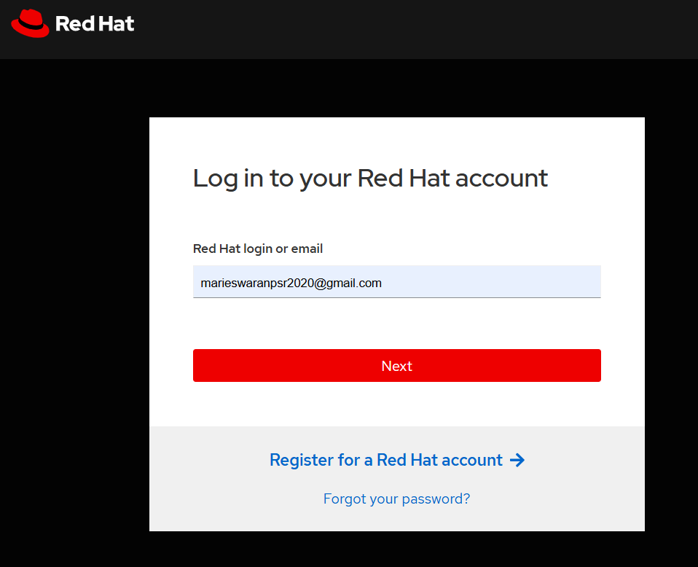
Enter Your username and password cloud lab portal login
Username : Mail ID Password : vectra123. portal login url : https://bit.ly/426f323

Slide 3
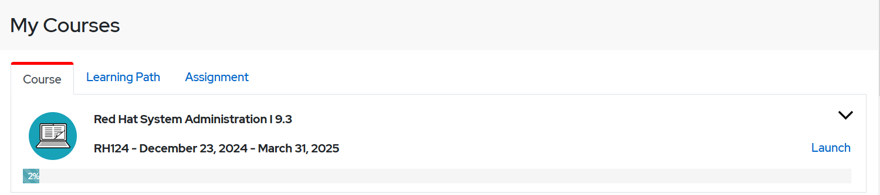
Click the Launch Button, this will take you to lab environment.

Slide 4
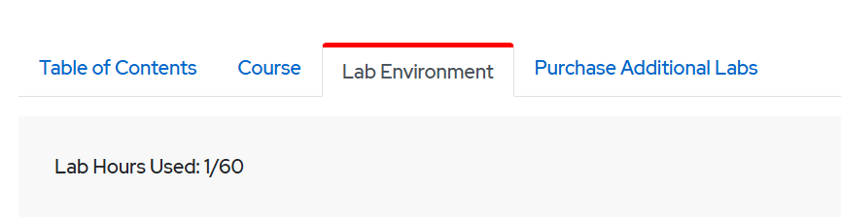
Click the Lab environment it shows the machines or Create button to create lab

Slide 5
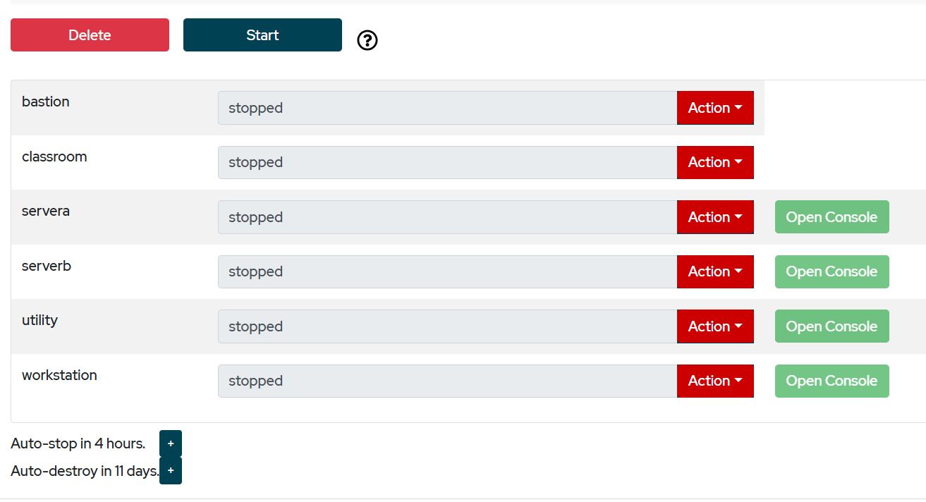
Click the start button to poweron the machines
Note : * Don’t forget to stop after use

Slide 6
After start the machine click the Open Console button, This will take you to the machine
Interface.

Slide 7
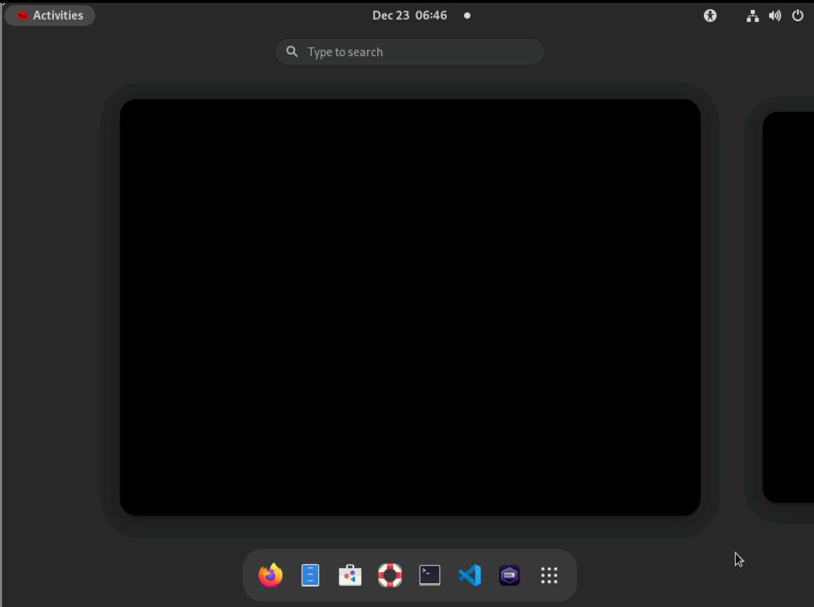
Click the Activities
Click the Terminal

Slide 8
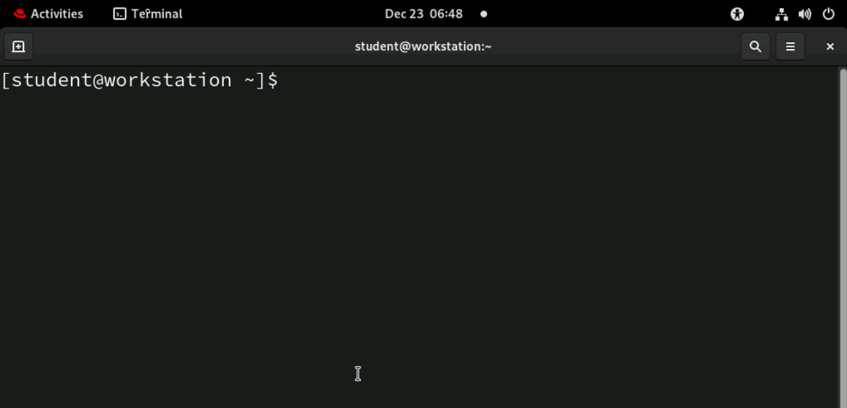
Now Follow the Attached Notes in our group

